Slide 1
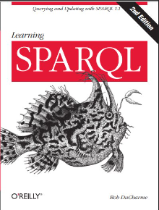
Learning
001
SPARQL
(opening & intro)
Author: Bob DuCharme
Xiaoqi Zhao, GitHub: https://github.com/yasenstar/Learn_SPARQL

Slide 2
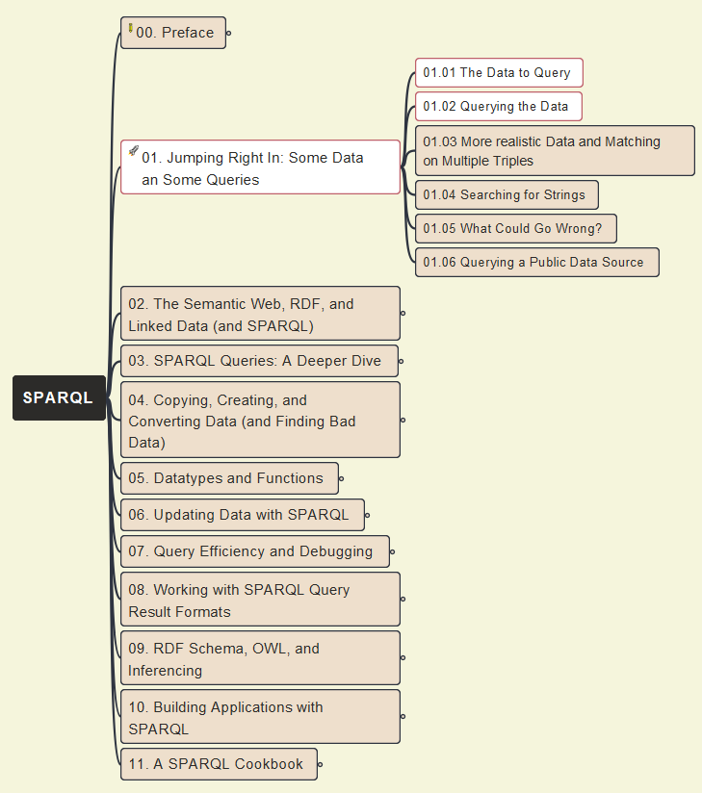
01- Jumping Right In
002 - Initial Data Query and Jena (ARQ) Tool

